Slide 1

Low power high performance priority encoder using 2D-array to 3D-array conversion

Slide 2
PRIORITY ENCODER
What is a priority encoder?
The Priority Encoder is a combinational logic circuit that contains a 2^n input lines and n output lines and represents the highest priority input among all the input lines. When the multiple input lines are active high at the same time, then the input that has the highest priority is considered first to generate the output.
It is used to solve the issues in binary encoders, which generate wrong output when more than one input line is active high. If more than one input line is active high at the same time, then this encoder prioritizes every input level and allocates the priority level to each input.

Slide 3
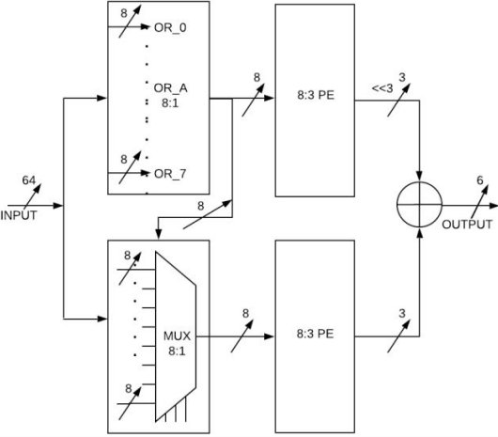
2D array-priority encoder 64 : 6
For reducing the power consumption in electronic devices, several circuits were proposed in literature. In parallel priority look-ahead 64-bit priority encoder architecture [1], there are 64 bits which are divided into eight parts. Each part contains 8-bits hence total of 8 x 8 =64. Given below is how a 2D array priority encoder looks.

Slide 4
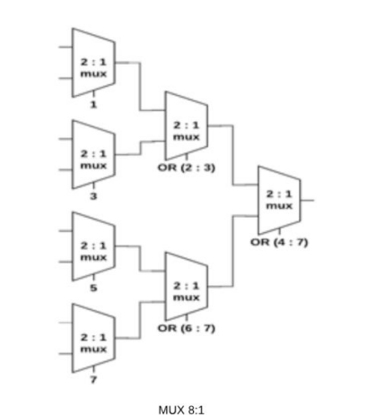
.
The individual 8-bits are input to the 8-input OR gates, in this way, this design have eight 8-input OR gates placed in parallel. All eight OR gates take eight 8-bits and generate eight single bit outputs. The eight single bit output is input to the 8-input priority encoder and is also used as selection pins for eight 8-bit, 8:1MUX. Each of these 8:1MUX is made of seven 2:1MUX as shown
One bit output is generated from one 8:1MUX and there are eight such MUX which will give 8-bit output which is going to act as an input for the priority encoder no2.

Slide 5
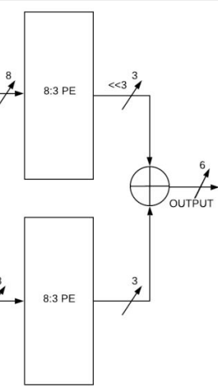
.
Now the 8-bit outputs of the OR-gates and MUX will be input to the priority encoders. We know that for any 2^n inputs for an priority encoder the outputs generated will be n so for a 8-bit input the output generated will be 3 and 3 each which together gives 6-bit as output for a 64-bit input.
Now let’s look at the system Verilog code and the rtl diagram.

Slide 6
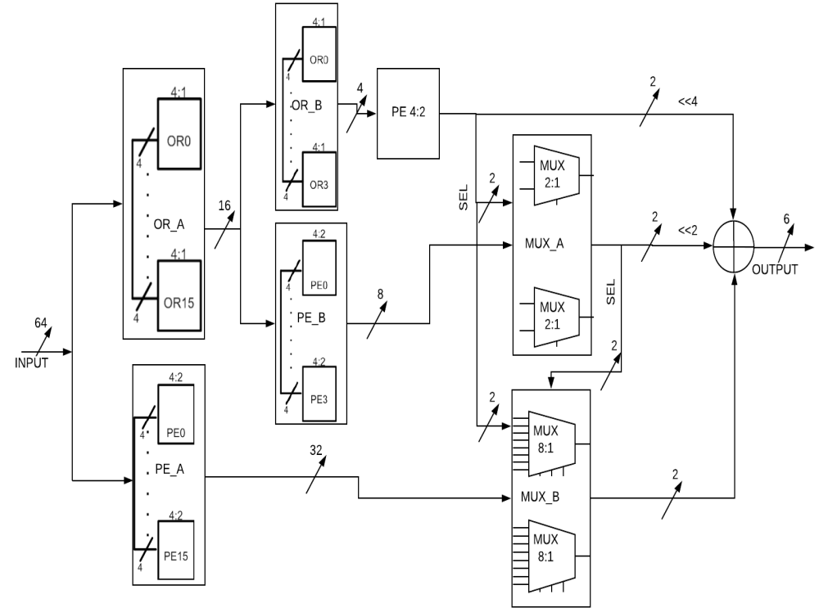
3D array-priority encoder 64 : 6
3D-array 64:6 priority encoder circuits consist of multiple blocks, which are OR_A, OR_B, PE_A, PE_B, MUX_A, MUX_B and PE 4:2. This OR_A block consists of sixteen 4-input OR gates those are OR0, OR1 and so on up to OR15, these sixteen 4-input OR gates are placed in parallel. PE_A block consists of sixteen 4:2 priority encoder, those are PE0, PE1 and so on up to PE15 are placed in parallel. Next block is OR_B block, which has four 4-input OR gates from OR0 to OR3, and the OR_B block take the input from OR_A block. The output from OR_B block is given to PE 4:2. Another block is PE_B, in this block there are four 4:2 priority encoder placed in parallel.

Slide 7
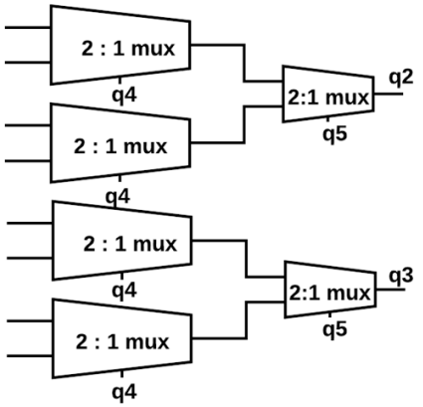
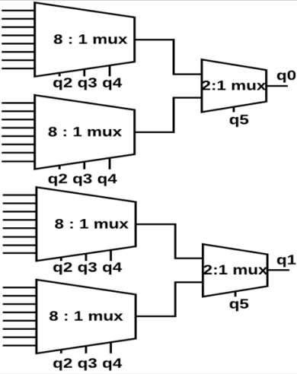
.
MUX_A block consists of six 2:1 MUX which are placed to get 2-bit output, and the selection lines of MUX_A block is taken from PE 4:2.
Now In the same manner MUX_B block is also designed, in this there are four 8-input MUX circuits which are placed in parallel and output of these 8:1 MUX are given to two 2-input MUX circuits. The selection lines for MUX_B circuit are taken from PE 4:2 priority encoder output and MUX_A output.

Slide 8
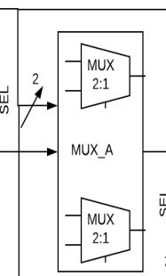
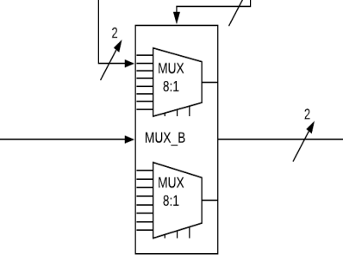
.
8-bit input 2-bit output
2-bit output of MUX_A
32-bit input 2-bit output

Slide 9
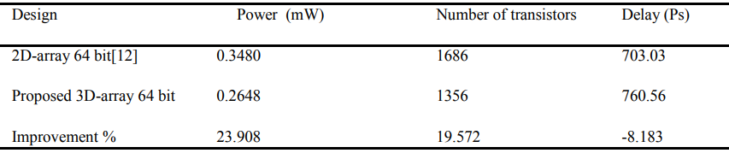
COMPARISON BETWEEN 2D AND 3D ARRAY PRIORITY ENCODER (180nm tech)
By implementing and analyzing the both 2D-array priority encoder and 3D-array priority encoder, power consumption of 2D-array priority encoder is 0.3480mW, 3D-array priority encoder is 0.2648mW. The reduction of power is 23.908 % for 3D-array priority encoder. In the same way the transistors required to implement the 2D-array priority encoder is 1686, and for 3D-array priority encoder is 1356. The number of transistors required is reduced by 19.572% when 3D-array priority encoder was used. Compared to the 2D-array priority encoder [12], 3D-array priority encoder delay is increased by 8.183 %

Slide 10
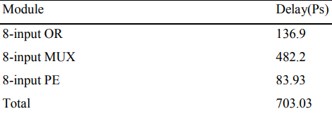
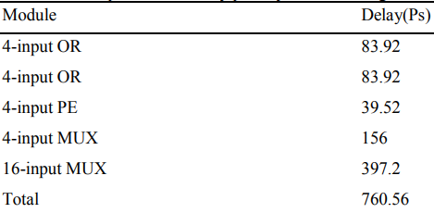
CRITICAL PATH FOR 2D AND 3D PRIORITY ENCODER (180nm technology)
Critical path for 2D array priority encoder:
Critical path for 3D array priority encoder:

Slide 11
THANK YOU HAVE A PLEASANT DAY
S

